Slide 1
Introduction to Big Data 2023-2024 Prof.dr.ing. Florin Pop florin.pop@cs.pub.ro Dr.ing. Cătălin Negru catalin.negru@cs.pub.ro Dr.ing. Bogdan Mocanu bogdan_costel.mocanu@upb.ro SCPD • SSA • ABD • SEM • RA

Slide 2

The Human Face of Big Data
Big Data will impact every part of your life: https://www.youtube.com/watch?v=0Q3sRSUYmys
What Exactly Is Big Data? https://www.forbes.com/video/4857597029001

Slide 3
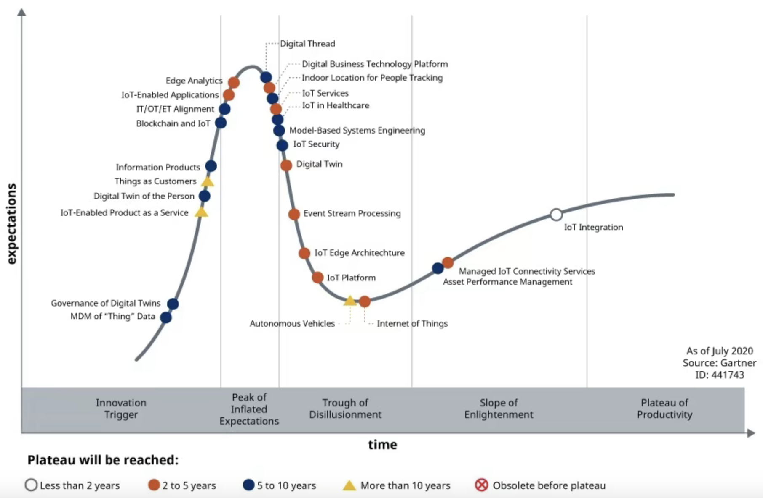
Gartner Tempers The Expectations Of Big Data

Slide 4
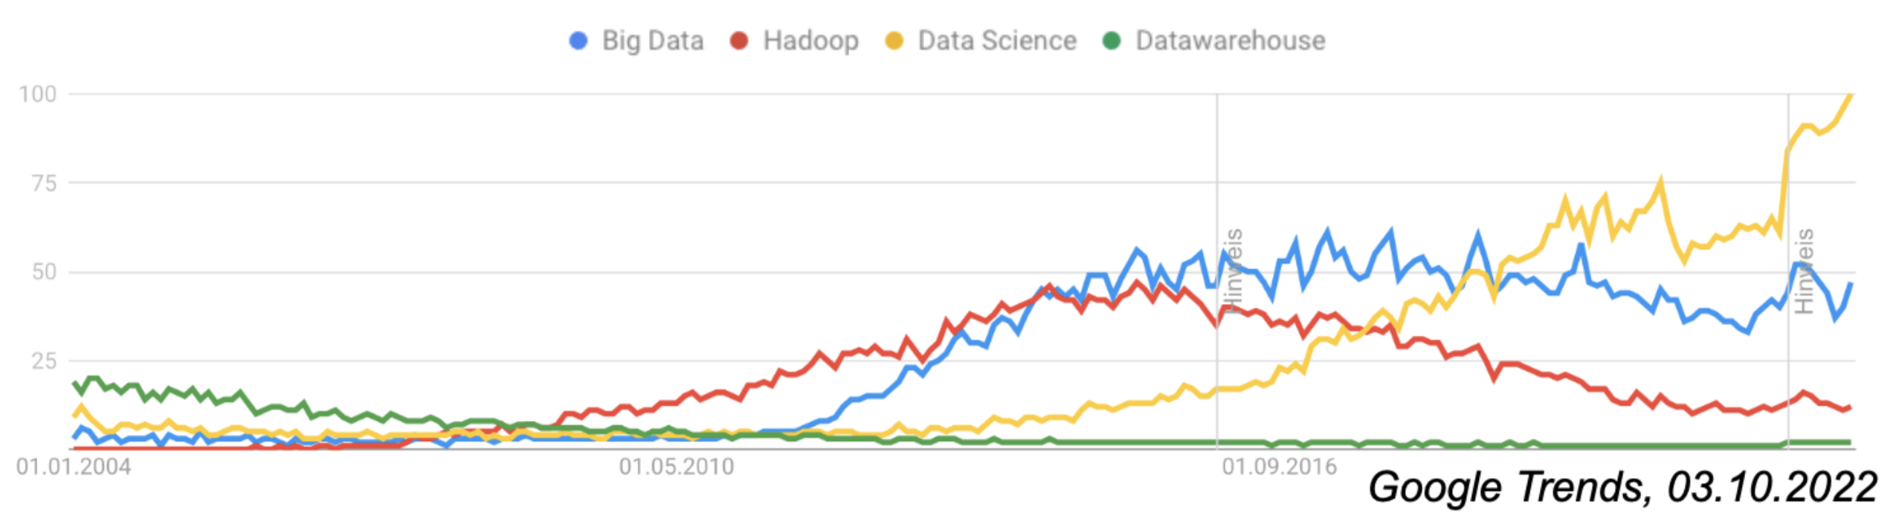
Google Trents

Slide 5
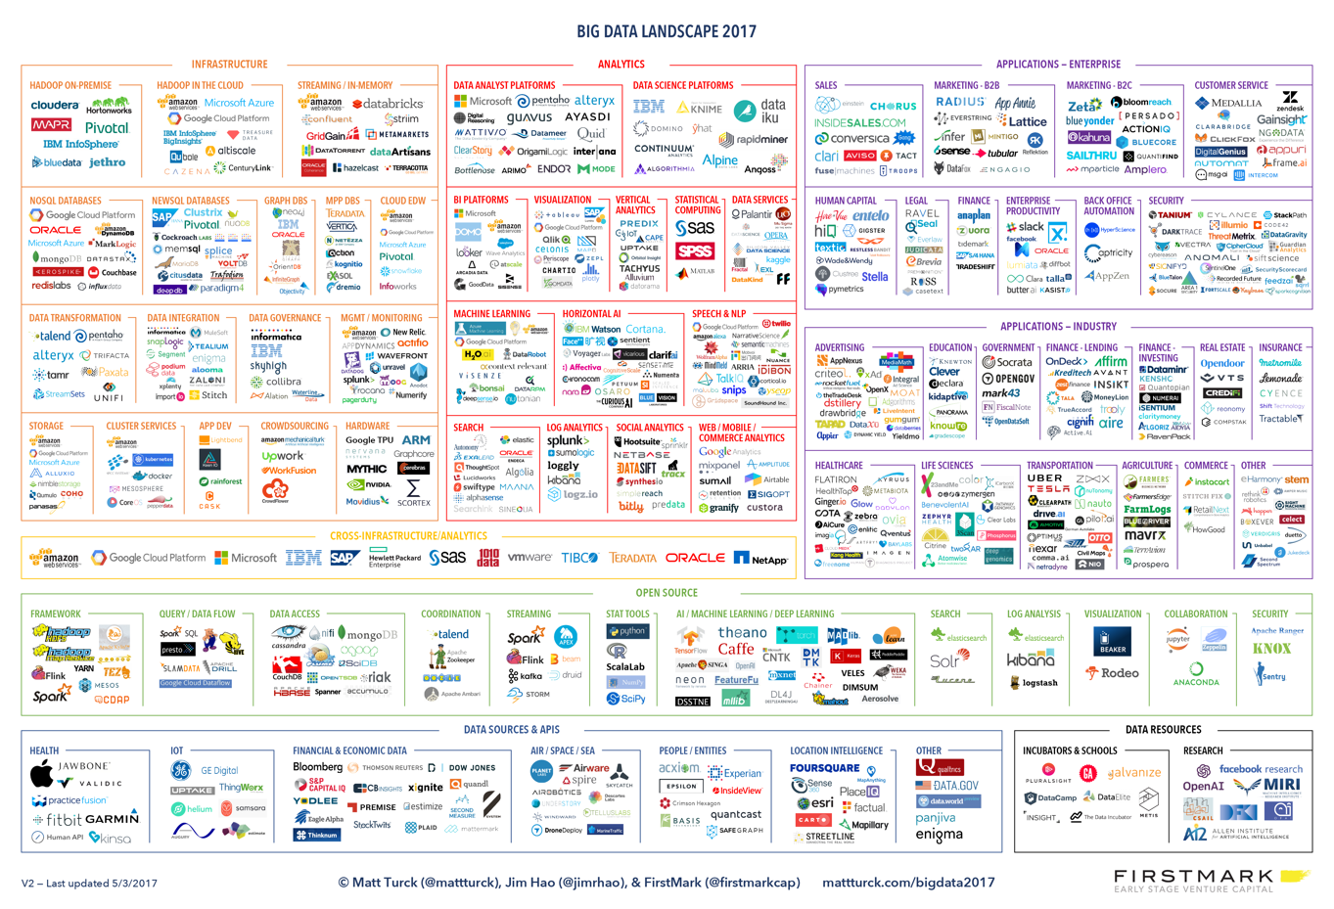
The 2017 Big Data Landscape

Slide 6
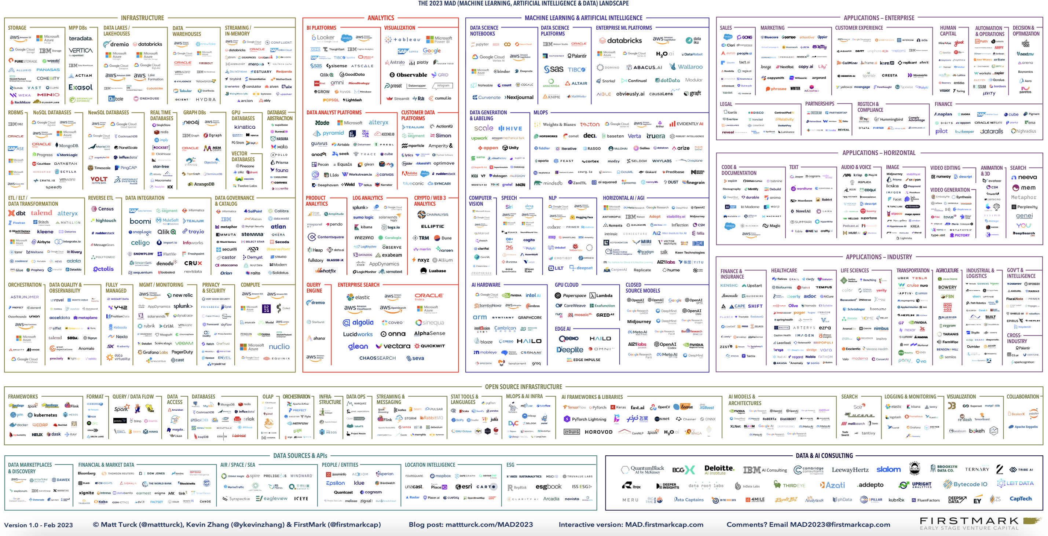
Data & AI Landscape 2023

Slide 7
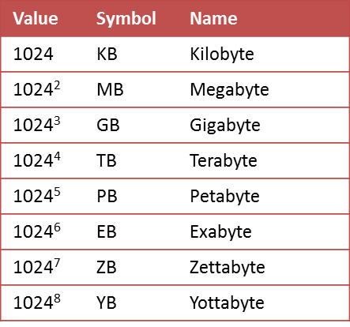
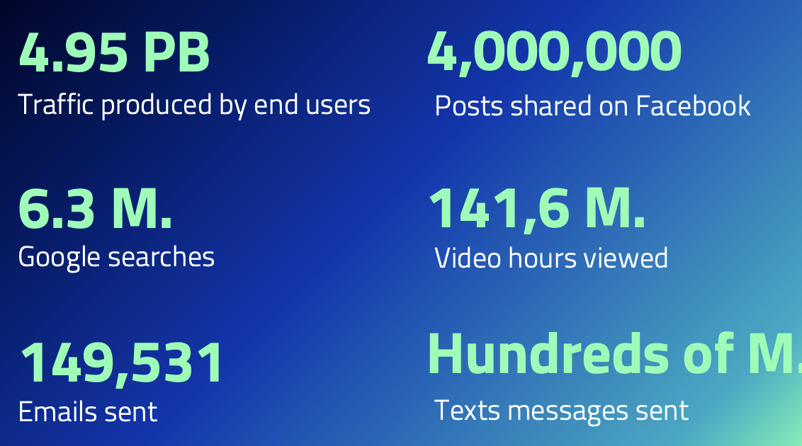
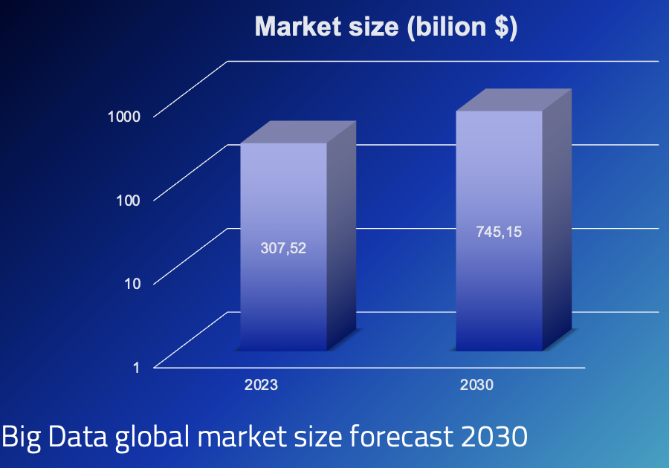
Understanding Big Data
328,770 PB bytes of data each day
Dataset whose volume, velocity, variety and complexity are beyond the ability of commonly used tools to capture, process, store, manage and analyze them can be termed as BIG DATA.

Slide 8
Complexity of Big Data
Data distribution
The large data set is split into chunks or smaller blocks and distributed over N number of nodes or machines.
Distributed File System.
Parallel processing
The distributed data gets the power of N number of servers and machines in which data is residing and works in parallel for the processing and analysis
MapReduce (Google), Hadoop, Spark, Flink, etc.

Slide 9
Complexity of Big Data
Fault tolerance
We keep the replica of a single block (or chunk) of data more than once.
Commodity hardware
We don’t need specialized hardware with special RAID as Data container.
Flexibility and Scalability
add more and more of rack space into the cluster as the demand for space increases.

Slide 10
A brief history of Data Science

Slide 11
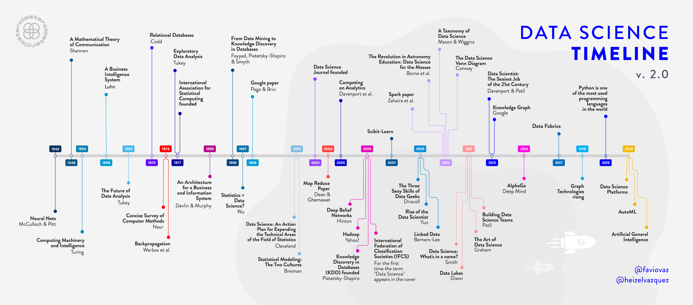
Big Data Timeline v2.0
Illustration by Héizel Vázquez

Slide 12
Big Data Research Challenges
Heterogeneity and incompleteness
machine analysis algorithms expect homogeneous data;
even after data cleaning and error correction, some incompleteness and some errors in data are likely to remain.
Scale
managing large and rapidly increasing volumes of data;
clock speeds have largely stalled and processors are being built with increasing numbers of cores;
parallelism across nodes in a cluster;
move towards cloud computing;
large clusters requires new ways of determining how to run and execute data processing jobs.

Slide 13
Big Data Research Challenges
Timeliness
acquisition rate challenge and a timeliness challenge;
many situations in which the result of the analysis is required immediately;
ex: a full analysis of a user’s purchase history is not likely to be feasible in real-time.
Privacy and security
important to rethink security for information sharing in Big Data use cases;
we do not understand what it means to share data
Cryptographic techniques
Compliance with GDPR and other standards
Human collaboration
analytics for Big Data will be designed to have a human in the loop;
crowd-sourcing;
issues of uncertainty and error => participatory-sensing;
the extra challenge here is the inherent uncertainty of the data collection devices.

Slide 14
Major Benefits of Big Data
Answer more questions, more completely
powerful big data business intelligence platform
uncovering hidden trends and patterns to performing in-depth market segmentation
Faster and better decision-making
data-driven evidence rather than intuition
enhance competitiveness
improve resource allocation
Become confident in your accurate data
solving the problem of inaccurate, incomplete view of the data

Slide 15
Major Benefits of Big Data
Empower a new generation of employees
data engineer/architect (data modeling, pipeline, stream/batch processing)
data ops (infrastructure deployment and CI/CD)
data scientists (work with datasets, develop models, analyze data, find patterns)
Cost reduction and revenue generation
allows businesses to streamline operations
optimize processes through data-driven insights
enables businesses to better understand customer behavior and preferences, facilitating targeted marketing campaigns

Slide 16
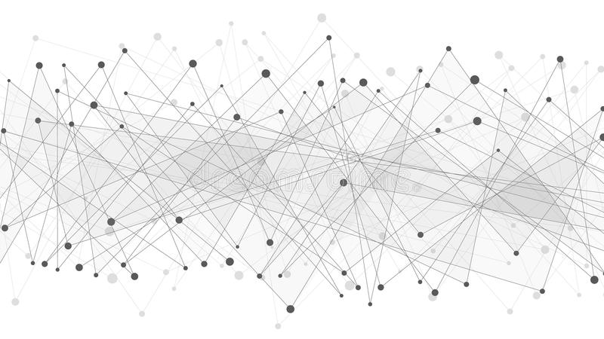
Big Remark
We must to support and we need to encourage
fundamental research towards addressing all scientific and technical challenges
if we want to achieve the promised benefits of
Big Data.

Slide 17
Introduction in Big Data. Distributed platforms Brief introduction
Datacenters, Cloud computing, HPC, Fog and Edge computing; Mobile computing; Vanet (V2X). Distributed Applications (practical use cases): Smart Cities; eHealth; eGovernment; Scientific Applications

Slide 18
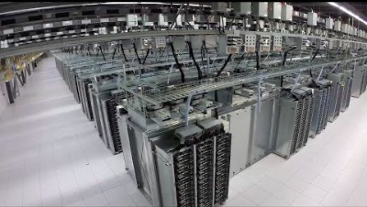
Datacenters
Processing Big Data, the Google Way

Slide 19
Datacenters components
Computing
Infrastructure
- Processing resources
- Memory resources
Network
Infrastructure
- Connected servers (physical and virtualised)
- Data centre services
- External conectivity
Storage
Infrastructure
- Storage systems used for data storage

Slide 20
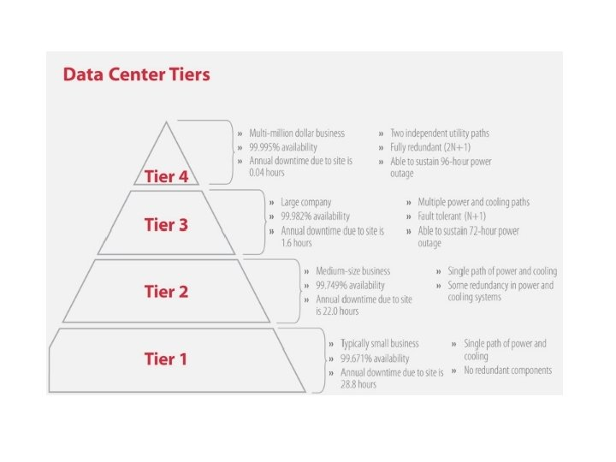
Data centre tier infrastructure

Slide 21
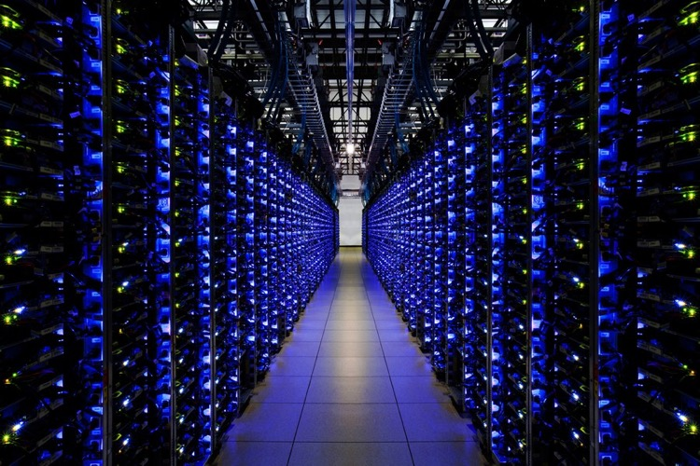
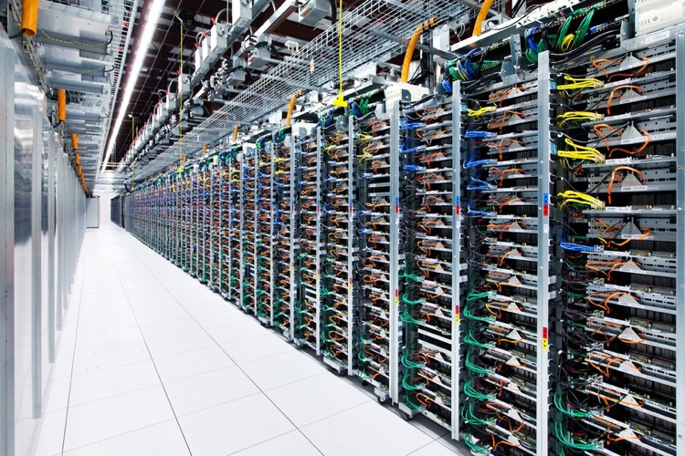
Datacenters
Processing Big Data, the Google Way
Photo: GOOGLE
Photo: GOOGLE
Twin banks of servers at the data center in Douglas County, Ga. use energy-thrifty blue LEDs as monitor lights.
Server racks at the data center in Mayes County, Okla.. Each server has four switches connected by a different colored cable. Google keeps the colors the same throughout our data center so it knows which one to replace in case of failure.

Slide 22



Cloud Computing
Definition by IBM:
Cloud computing, often referred to as simply “the cloud,” is the delivery of on-demand computing resources—everything from applications to data centers—over the internet on a pay-for-use basis.
Cloud Computing Services:
Software as a Service (SaaS):
applications are supplied by the cloud provider;
applications are accessible from various client devices (e.g. web browser, API);
Examples: GMAIL, Dropbox, Office 365, Amazon Web Services
Platform as a Service (PaaS)
deploy applications onto the Cloud infrastructure
programming languages, tools and libraries are supported by the provider;
control over the deployed applications
Infrastructure as a Service (IaaS)
provision with fundamental computing resources: VM’s (CPU, storage, network);
resources are distributed and support dynamic scaling;
deploy and run arbitrary software, meaning middleware, and operating systems;
control over operating systems, storage, and deployed applications
User does not manage or control the underlying Cloud infrastructure.

Slide 23
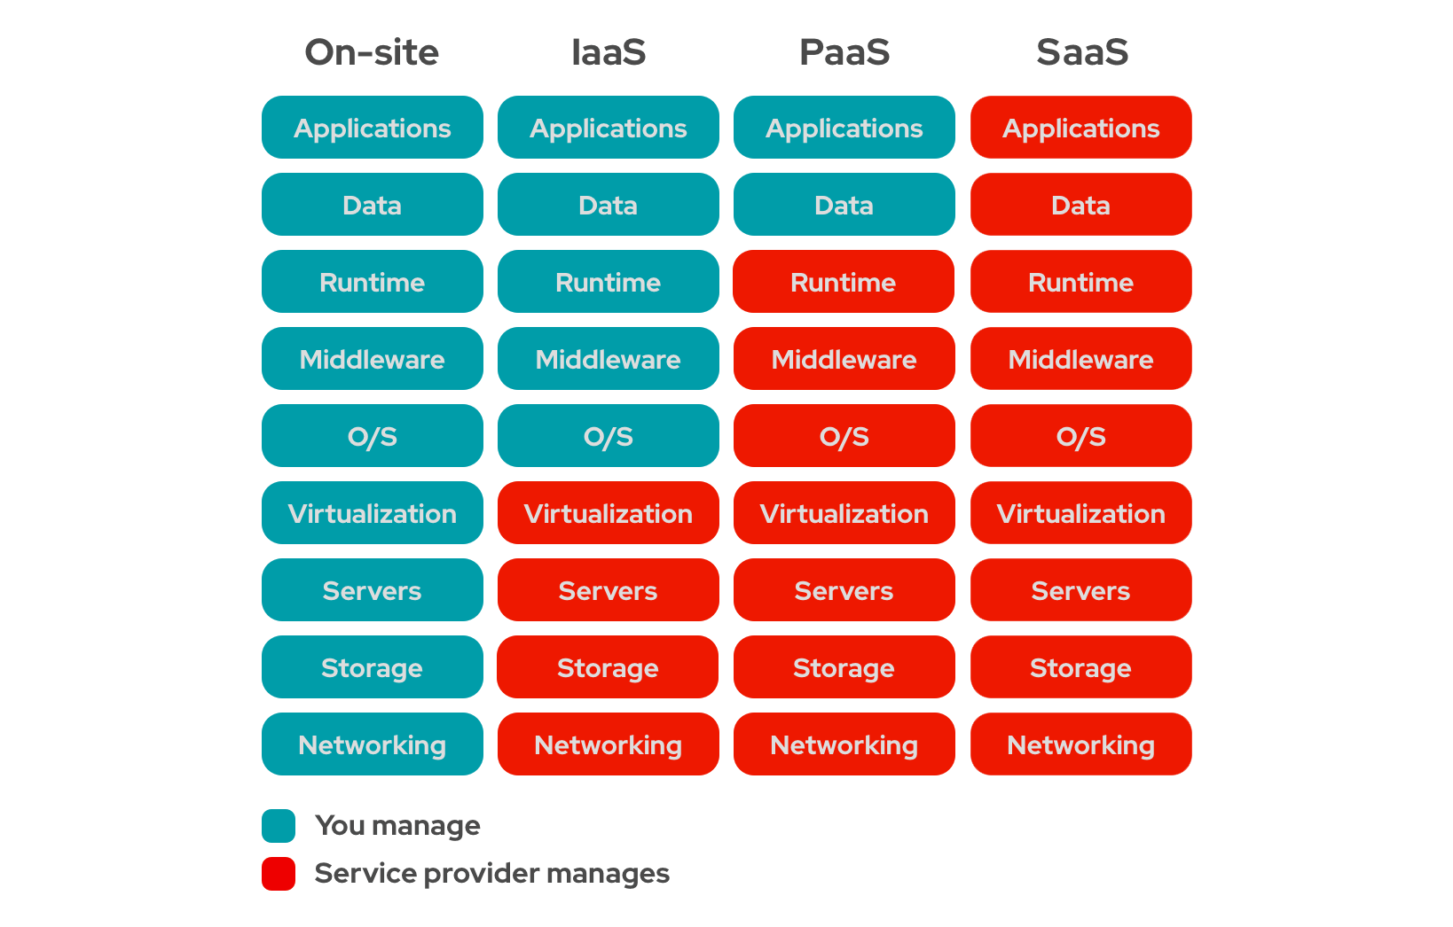
Cloud computing

Slide 24
Cloud Computing - Deployment models
Private
Single-tenant architecture
On-premises hardware
Direct control of infrastruscure
Ex: IBM, Red Had, Microsoft, OpenStack, ownCloud
Public
Multi-tenant architecture
Pay-as-you-go pricing model
Ex: AWS, Microsoft Azure, Google Cloud Platform
Hybrid
Cloud bursting capabilities
Benefit of both public and private environments
Ex: combination of both public and private providers

Slide 25
HPC
High Performance Computing most generally refers to the practice of aggregating computing power in a way that delivers much higher performance than one could get out of a typical desktop computer or workstation in order to solve large problems in science, engineering, or business.

Slide 26
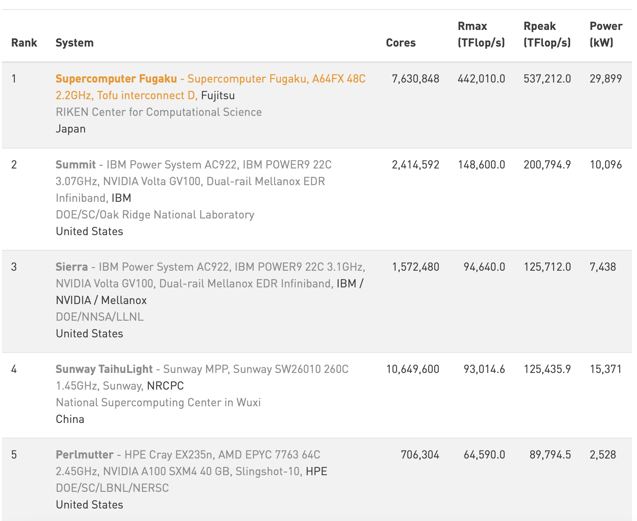
Top 5 World supercomputers
https://www.top500.org/lists/top500/2021/06/

Slide 27
Fog and Edge Computing

Slide 28
Mobile computing

Slide 29
Vanet (V2X)-Vehicular ad hoc networks
Vehicle-to-Vehicle (V2V) among vehicles
A wireless ad hoc network on the roads, suited for short range vehicular networks;
Vehicle-to-Infrastructure (V2I) between vehicles and Road-side-Units
Long range vehicular networks;
Vehicle-to-X (V2X) mixed approach
Vehicle-to-everything

Slide 30
Practical applications
Smart Cities
eHealth
eGouverment
Scientific applications
…

Slide 31
Data Science and the Values of Big Data
The 8V’s: Volume, Velocity, Variety, Variability, Visualization, Value, Veracity, Vicissitude;
Use cases and current challenges

Slide 32
Starting V

Slide 33
Volume
Big Data Volume refers to the large amounts of generated data:
40 ZettaBytes by 2020;
300 times more than 2005;
~ 2.5 Quintillion (2.3 Trillions GB) bytes data created daily;
100 Terabytes per company stored;
6 billion cell phones;
7 billon peoples.
Volume challenges:
Storage, analysis and processing;
Even the smallest optimization represents a step ahead in getting the meaningful data in time and at a low cost;

Slide 34
Velocity
Velocity refers to the speed of generating data (the speed at which the data is flowing):
New York Stock Exchange captures 1TB of trade information during each trading session;
Modern cars have about 100 sensors;
~18.9 billion network connections
about 2.5 connections per person;
Social media messages are
spread in seconds;
Velocity challenges:
Response time of delivery services (for financial markets is real-time);
Speed of manipulating and analyzing complex data;
The Big Data system must be able to adjust and deal with the high loads of data at peak times;

Slide 35
Variety
Variety refers to the diversity of data:
150 Exabytes in healthcare (2011);
~30 billion pieces of contend shared on
Facebook;
By 2014 ~420 mil. wearable, wireless
health monitors;
4 billion hours of videos watched on YouTube per month;
400 million tweets send /day by 200 mil. active users;
Variety challenges:
Big Data systems should handle complex data: relational data, raw data, semi-structured or unstructured data;
Almost 80% of the world’s data is now unorganized;
traditional DB can’t be used anymore for storage and management
different types of data must be processed and mapped to dedicated resources;

Slide 36
Variability
Variability refers to data whose meaning is constantly changing;
For example words don’t have static definitions and meaning vary in context:
“Delicious muesli from the @imaginarycafe- what a great way to start the day!”
“Greatly disappointed that my local Imaginary Cafe have stopped stocking BLTs.”
“Had to wait in line for 45 minutes at the Imaginary Cafe today. Great, well there’s my lunchbreak gone…”
“great” on its own is not a sufficient signifier of positive sentiment;
Variability challenges:
‘Understand’ context and decode the precise meaning of words

Slide 37
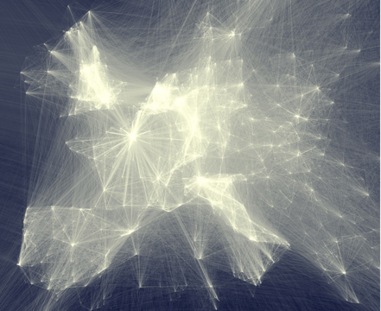
Visualization
Visualization refers to presentation of data in a pictorial or graphical format:
Analytics presented visually:
to understand difficult concepts;
to identify new patters;
Interactive visualization:
charts;
graphs;
ex: https://d3js.org/, https://developers.google.com/chart/ , http://www.fusioncharts.com/,
Visualization challenges:
Develop new techniques for data visualization;
Data exploration;
Inconsistencies in the data structure;

Slide 38
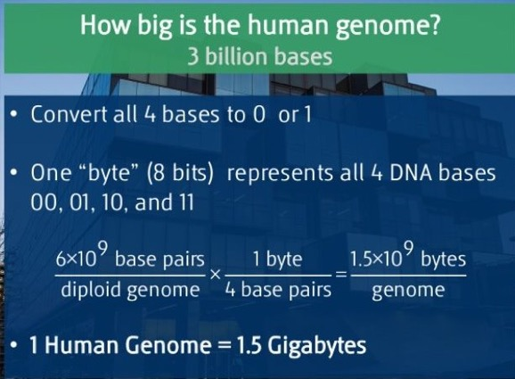
Value
Value refers to the value that can be extracted form datasets:
it does not matter how big the data volume is or how complex,
it is unless we are able to extract the meaningful information;
storing and processing meaningless data represents:
a waste of money, time,
and obtaining the relevant information becomes harder;
Traditional approach to Big Data: systems for storing big data, but getting insights can be difficult:
time-intensive, manual query and analysis;
modern dashboarding tools;
Modern approach to Big Data:
Machine brains: specialized algorithms that :
can learn to identify patterns,
correlations and
Indicators through training and repetition;
Big Data Value challenges:
developing tools for getting value form Big Data;

Slide 39
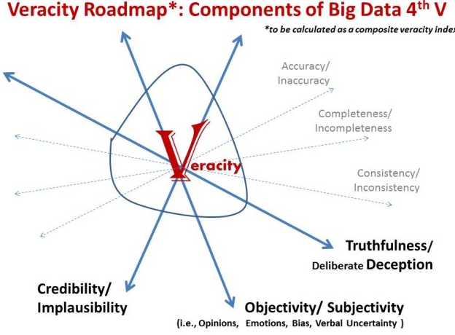
Veracity
Veracity refers to the trustworthiness of the data (uncertainty of data):
1 in 3 business leaders don’t trust the information they use to make decisions;
27% of respondents in one survey were unsure how much of their data was inaccurate;
Poor data quality cost US economy about $1.3 trillion/year;
Causes of veracity:
Rumors, spammers, collection errors,
entry errors, system errors;
Veracity challenges:
the volume and complexity of data
are increasing;
quality and accuracy are becoming
less controllable;

Slide 40
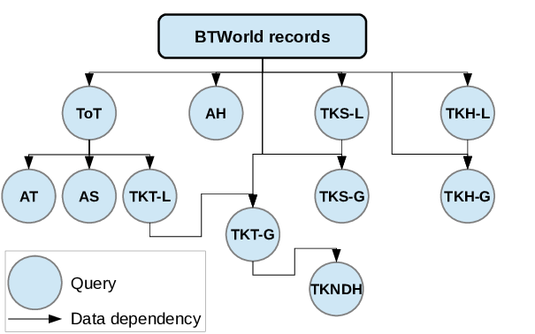
Vicissitude
Vicissitude property refers to the challenge of scaling Big Data complex workflows;
BTWorld: A Large-scale Experiment in Time-Based Analytics

Slide 41
+ more Vs of Big Data
+ Volatility
+ Veridicity
+ Vision
+ …

Slide 42
World population
- 11% are in Europe
- 5% are in North America
- 9% are in South America
- 15% are in Africa
- 60% live in Asia
- 49% live in rural areas
- 51% live in the city
- 12% speak Chinese
- 5% speak Spanish
- 5% speak English
- 3% speak Arabic
- 3% speak Hindi
- 3% speak Bengali
- 3% speak Portuguese
- 2% speak Russian
- 2% speak Japanese
- 62% speak their own mother tongue.
- 77% have their own or rented house.
- 23% have no accommodation.
- 21% consume more calories than necessary
- 63% can eat three complete meals.
- 15% are malnourished, they ate the last meal, but did not go to the next one.
- 48% daily cost of living is less than $2.00
- 87% have drinking water.
- 13% do not have drinking water and/or have access only to a contaminated water source.
- 75% have mobile phones
- 25% do not have
- 30% have access to the internet.
- 70% do not connect.
- 7% received university education.
- 93% did not attend college.
- 83% can read.
- 17% are illiterate.
- 33% are Christians
- 22% are Muslims
- 14% are Hindus
- 7% are Buddhists
- 12% belong to other religions
- 12% are atheists, without religious beliefs
- 26% are under 14 years old
- 66% died between 15 and 64 years old
- 8% are over 65 years old.
Statistics provided by Animal Planet by 2020
More:
https://livingplanet.panda.org
https://ourworldindata.org
https://ourworldindata.org/living-planet-index

Slide 43
10 Cool Big Data Projects
#1. To find exactly what we look for in the internet
#2. To ride through a city without traffic jams
#3. To save rare animals, catching poachers
#4. To make our cities green
#5. To understand why Indian cuisine is unique
#6. To fight malaria epidemics in Africa
#7. To grow ideal Christmas trees
#8. To understand that our languages are filled with happiness
#9. To make sport shows even more interesting
#10. To improve job conditions
#11. To enhance relationship
https://www.kaspersky.com/blog/cool-big-data-projects/8186/

Slide 44
Distributed Model for Scalable Batch Computing
Google MapReduce. MapReduce Patterns, Algorithms and use cases

Slide 45
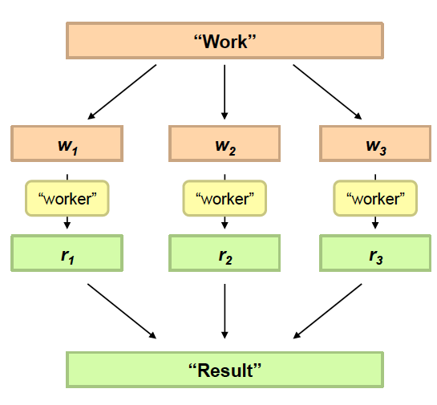
Philosophy to Scale for Big Data
Divide Work
Combine Results

Slide 46
Distributed processing is non-trivial
How to assign tasks to different workers in an efficient way?
What happens if tasks fail?
How do workers exchange results?
How to synchronize distributed tasks allocated to different workers?
Big Data storage is challenging
Data Volumes are massive
Reliability of Storing PBs of data is challenging
All kinds of failures: Disk/Hardware/Network Failures
Probability of failures simply increase with the number of machines …

Slide 47
Google MapReduce
MapReduce is:
a programming model;
implementation for processing and generating big data sets;
Released in 2004 by Google (Jeffrey Dean and Sanjay Ghemawat)
Perform simple computations while hiding the details of:
Parallelization;
Data distribution;
Load balancing;
I/O scheduling;
Fault tolerance;
Distribute data over multiple nodes
Each node receive a small portion of data
Large Dataset
MAP
REDUCE
Split data
Split data
Results
Split data
…
Split data

Slide 48
Google MapReduce (2)
MapReduce programming model:
Input & Output: each a set of key/value pairs
Programmer must specifies two functions:
map (in_key, in_value) → list(out_key, intermediate_value)
Processes input key/value pair;
Produces set of intermediate pairs;
reduce (out_key, list(intermediate_value)) → list(out_value)
Combines all intermediate values for a particular key;
Produces a set of merged output values;
map(String input_key, String input_value):
// input_key: document name
// input_value: document contents f
for each word w in input_value: EmitIntermediate(w, "1");
reduce(String output_key, Iterator intermediate_values):
// output_key: a word
// output_values: a list of counts int result = 0;
for each v in intermediate_values: result += ParseInt(v); Emit(AsString(result));

Slide 49
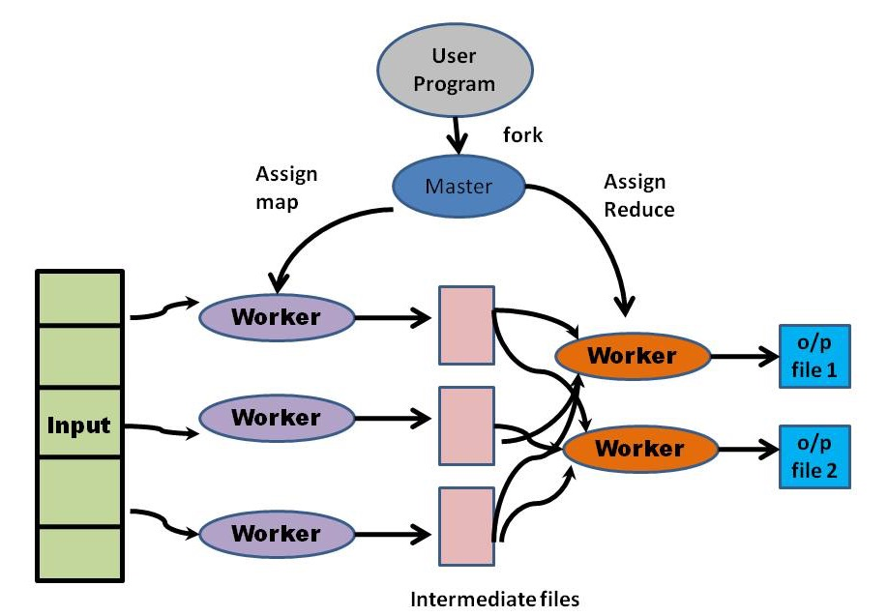
MapReduce Architecture

Slide 50
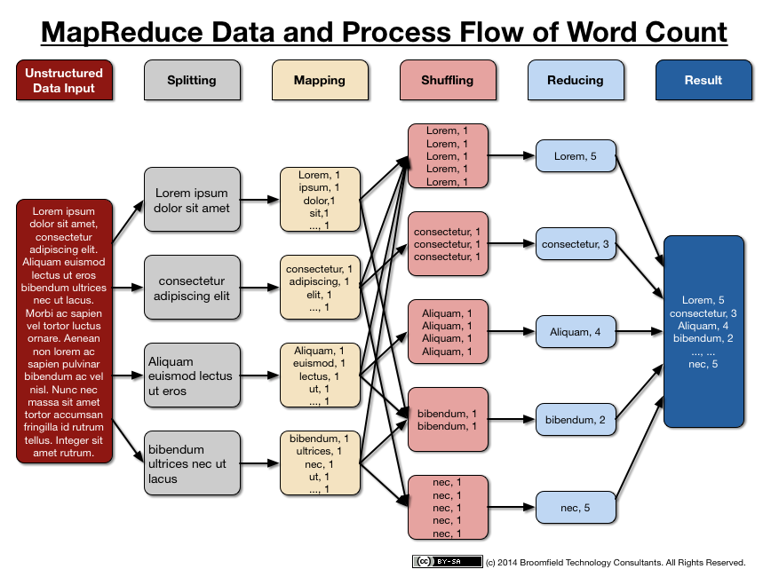
MapReduce Data Flow

Slide 51
MapReduce Patterns
Counting and Summing - log analysis, data querying:
Calculate a total number of occurrences of each word in a large set of documents;
Process a log file :
each record contains a response time;
it is required to calculate an average response time.
Collating – ETL, building of inverted indexes:
Save all items that have the same value of a function into one file
Filtering (“Grepping”), Parsing, and Validation - log analysis, data querying, ETL, data validation:
Collect all records that meet some condition;
Transform each record (independently from other records) into another representation

Slide 52
MapReduce Patterns (2)
Distributed Task Execution – physics and engineering simulations, numerical analysis, performance testing:
Large computational divided into multiple parts;
Results from all parts are combined together to obtain a final result.
Sorting - ETL, data analysis:
Sort large set of records by some rule;
Process records in a certain order.
Iterative Message Passing (Graph Processing) - graph analysis, web indexing:
Calculate a state of each entity in a network on the basis of properties of the other entities in its neighborhood;
State can represent :
distance to other nodes;
indication that there is a neighbor with the certain properties;
characteristic of neighborhood density ;
etc.

Slide 53
MapReduce Patterns (3)
Distinct Values (Unique Items Counting) – log analysis, unique users counting
Set of records that contain fields F and G;
Count the total number of unique values of field F for each subset of records that have the same G (grouped by G).
Cross-Correlation -text analysis, market analysis:
A set of tuples of items ;
Calculate a number of tuples where some items co-occur for each possible pair.
Relational MapReduce Patterns:
Selection
Projection
Union
Intersection
Difference
GroupBy and Aggregation
Joining

Slide 54
Algorithms and use cases
PageRank and Mapper-Side Data Aggregation
Used by Google to calculate relevance of a web page as a function of authoritativeness (PageRank) of pages that have links to this page.
the algorithm is complex
its core it is just a propagation of weights between nodes
each node calculates its weight as a mean of the incoming weights:
class N
State is PageRank
method getMessage(object N)
return N.State / N.OutgoingRelations.size()
method calculateState(state s, data [d1, d2,…])
return ( sum([d1, d2,...]) )
class Mapper
method Initialize
H = new AssociativeArray
method Map(id n, object N)
p = N.PageRank / N.OutgoingRelations.size()
Emit(id n, object N)
for all id m in N.OutgoingRelations do
H{m} = H{m} + p
method Close
for all id n in H do
Emit(id n, value H{n})
class Reducer
method Reduce(id m, [s1, s2,...])
M = null
p = 0
for all s in [s1, s2,...] do
if IsObject(s) then
M = s
else
p = p + s
M.PageRank = p
Emit(id m, item M)

Slide 55
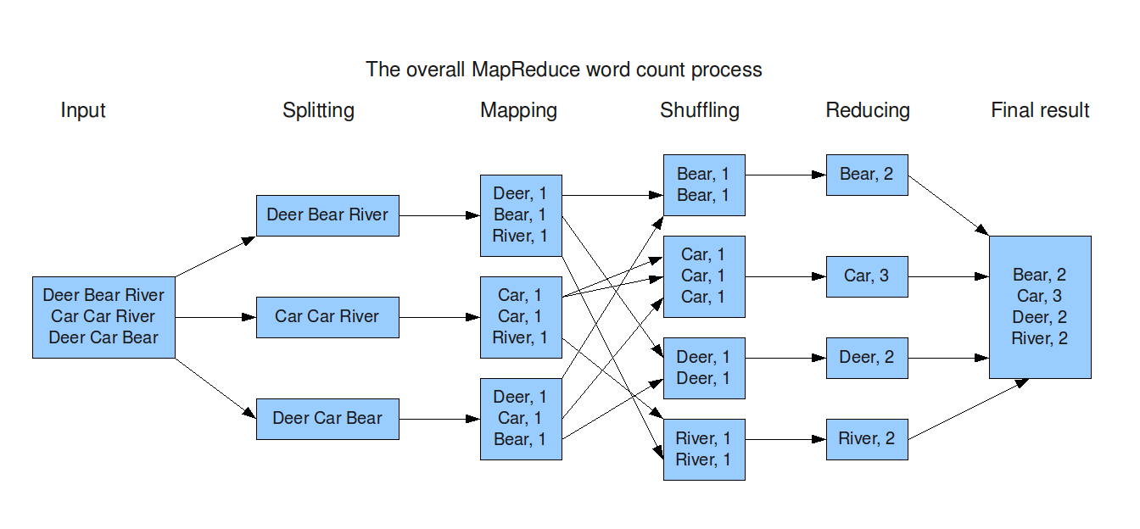
Word Count Example
Mapper
Input: value: lines of text of input
Output: key: word, value: 1
Reducer
Input: key: word, value: set of counts
Output: key: word, value: sum
Launching program
Defines this job
Submits job to cluster
Owen O’Malley (Yahoo!)

Slide 56
Word Count Mapper
public static class Map extends MapReduceBase implements Mapper<LongWritable,Text,Text,IntWritable> {
private static final IntWritable one = new IntWritable(1);
private Text word = new Text();
public static void map(LongWritable key, Text value, OutputCollector<Text,IntWritable> output, Reporter reporter) throws IOException {
String line = value.toString();
StringTokenizer = new StringTokenizer(line);
while(tokenizer.hasNext()) {
word.set(tokenizer.nextToken());
output.collect(word,one);
}
}
}

Slide 57
Word Count Reducer
public static class Reduce extends MapReduceBase implements Reducer<Text,IntWritable,Text,IntWritable> {
public static void reduce(Text key, Iterator<IntWritable> values, OutputCollector<Text,IntWritable> output, Reporter reporter) throws IOException {
int sum = 0;
while(values.hasNext()) {
sum += values.next().get();
}
output.collect(key, new IntWritable(sum));
}
}

Slide 58
Putting it all together
JobConf conf = new JobConf(WordCount.class);
conf.setJobName(“wordcount”);
conf.setOutputKeyClass(Text.class);
conf.setOutputValueClass(IntWritable.class);
conf.setMapperClass(Map.class);
conf.setCombinerClass(Reduce.class);
conf.setReducer(Reduce.class);
conf.setInputFormat(TextInputFormat.class);
Conf.setOutputFormat(TextOutputFormat.class);
FileInputFormat.setInputPaths(conf, new Path(args[0]));
FileOutputFormat.setOutputPath(conf, new Path(args[1]));
JobClient.runJob(conf);

Slide 59
Apache Hadoop
Programming environment and use cases
* Based on slides by Dhruba Borthakur, Owen O’Malley (Yahoo!)

Slide 60
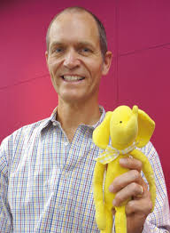
The history of an elephant
Hadoop is an open-source implementation based on Google File System (GFS) and MapReduce from Google
Hadoop was created by Doug Cutting and Mike Cafarella in 2005
Hadoop is an Apache open source project from 2006
Why Hadoop?
Need to process huge datasets on large clusters of computers
Very expensive to build reliability into each application
Nodes fail every day
Failure is expected, rather than exceptional
The number of nodes in a cluster is not constant
Need a common infrastructure
Efficient, reliable, easy to use

Slide 61
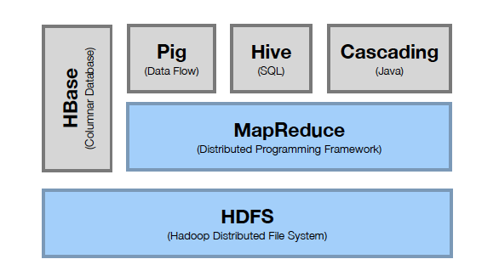
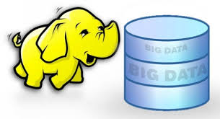
Apache Hadoop Basic Modules
Computation
Storage

Slide 62
Distributed File System
Single Namespace for entire cluster
Data Coherency
Write-once-read-many access model
Client can only append to existing files
Files are broken up into blocks
Typically 64MB block size
Each block replicated on multiple Data Nodes
Intelligent Client
Client can find location of blocks
Client accesses data directly from Data Node

Slide 63
Hadoop HDFS
Hadoop distributed File System (based on Google File System (GFS) paper, 2004)
Serves as the distributed file system for most tools in the Hadoop ecosystem
Scalability for large data sets
Reliability to cope with hardware failures
HDFS good for:
Large files
Streaming data
Not good for:
Lots of small files
Random access to files
Low latency access

Slide 64
Design of HDFS
Master-Slave design
Master Node
Single NameNode for managing metadata
Slave Nodes
Multiple DataNodes for storing data
Other
Secondary NameNode as a backup
HDFS files are divided into blocks
It’s the basic unit of read/write
Default size is 64MB, could be larger (128MB)
Hence makes HDFS good for storing larger files
HDFS blocks are replicated multiple times
One block stored at multiple location, also at different racks (usually 3 times)
This makes HDFS storage fault tolerant and faster to read
Client
NameNode
Secondary NameNode
DataNode
DataNode
DataNode
DataNode
NameNode keeps the metadata, the name, location and directory
DataNode provide storage for blocks of data
DataNode
DataNode
DataNode
DataNode
Heartbeat, Commands, Data

Slide 65

HDFS Architecture

Slide 66
HDFS Inside: Blocks
Reasons:
File can be larger than a single disk
Block is of fixed size, easy to manage and manipulate
Easy to replicate and do more fine grained load balancing
HDFS Block size is by default 64 MB (larger than regular file system block)
Minimize overhead: disk seek time is almost constant
Example: seek time: 10 msec, file transfer rate: 100MB/s, overhead (seek time/a block transfer time) is 1%, what is the block size?
100 MB (HDFS -> 128 MB)

Slide 67
NameNode Metadata
Metadata in Memory
The entire metadata is in main memory
No demand paging of metadata
Types of metadata
List of files
List of Blocks for each file
List of DataNodes for each block
File attributes, e.g. creation time, replication factor
A Transaction Log
Records file creations, file deletions etc.

Slide 68
DataNode
A Block Server
Stores data in the local file system (e.g. ext3)
Stores metadata of a block (e.g. CRC)
Serves data and metadata to Clients
Block Report
Periodically sends a report of all existing blocks to the NameNode
Facilitates Pipelining of Data
Forwards data to other specified DataNodes

Slide 69
Block Placement and Heartbeats
Current Strategy
One replica on local node
Second replica on a remote rack
Third replica on same remote rack
Additional replicas are randomly placed
Clients read from nearest replicas
Would like to make this policy pluggable
DataNodes send hearbeat to the NameNode
Once every 3 seconds
NameNode uses heartbeats to detect DataNode failure

Slide 70
Fault tolerance support in HDFS
Replication of blocks for fault tolerance
File
B1
B2
B3
B4
Node
Node
Node
Node
B1
B2
B4
B3
Node
Node
Node
Node
B1
B3
B1
B2
B4
Node
Node
Node
Node
B4
B3
B1
B2

Slide 71
HDFS Inside: Name Node
Name Node
Snapshot of FS
Edit log: record changes to FS
Filename | Replication factor | Block ID
File 1 | 3 | [1, 2, 3]
File 2 | 2 | [4, 5, 6]
File 3 | 1 | [7,8]
Data Nodes
1, 2, 5, 7,
4, 3
1, 5, 3,
2, 8, 6
1, 4, 3,
2, 6

Slide 72
HDFS Inside: Read
1
Name Node
Client
2
Prevent NN from being the bottleneck of the cluster
Allow HDFS to scale to large number of concurrent clients
Spread the data traffic across the cluster
3
4
DN1
DN2
DN3
. . .
DNn
Client connects to NN to read data
NN tells client where to find the data blocks
Client reads blocks directly from data nodes (without going through NN)
In case of node failures, client connects to another node that serves the missing block

Slide 73
HDFS Inside: Write
1
Name Node
Tradeoffs: Reliability, Write Bandwidth and Read Bandwidth
Client
2
4
3
DN1
DN2
DN3
. . .
DNn
Client connects to NN to write data
NN tells client write these data nodes
Client writes blocks directly to data nodes with desired replication factor
In case of node failures, NN will figure it out and replicate the missing blocks

Slide 74
Example of HDFS shell commands
Create a directory in HDFS
hadoop fs -mkdir /user/bigdata/dir1
List the content of a directory
hadoop fs -ls /user/bigdata
Upload and download a file in HDFS
hadoop fs -put /home/bigdata/file.txt /user/bigdata/datadir/
hadoop fs -get /user/bigdata/datadir/file.txt /home/
Look at the content of a file
hadoop fs -cat /user/bigdata/datadir/book.txt
Many more commands, similar to Unix

Slide 75
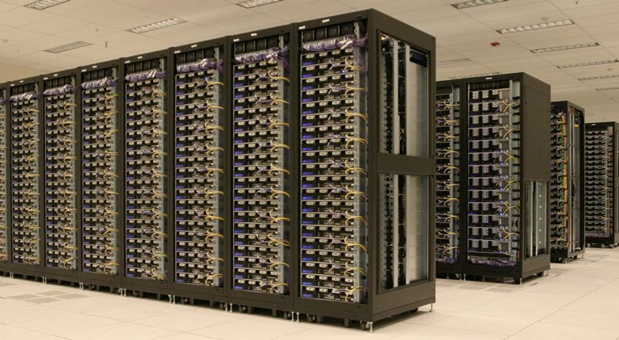
Who uses Hadoop?
Amazon/A9
Facebook
Google
New York Times
Veoh
Yahoo!
…. many more
Hadoop Cluster at Yahoo! (Credit: Yahoo)

Slide 76
A real world example of New York Times
Goal: Make entire archive of articles available online: 11 million, from 1851
Task: Translate 4 TB TIFF images to PDF files
Solution: Used Amazon Elastic Compute Cloud (EC2) and Simple Storage System (S3)
Time: < 24 hours
Costs: ~ $240

Slide 77
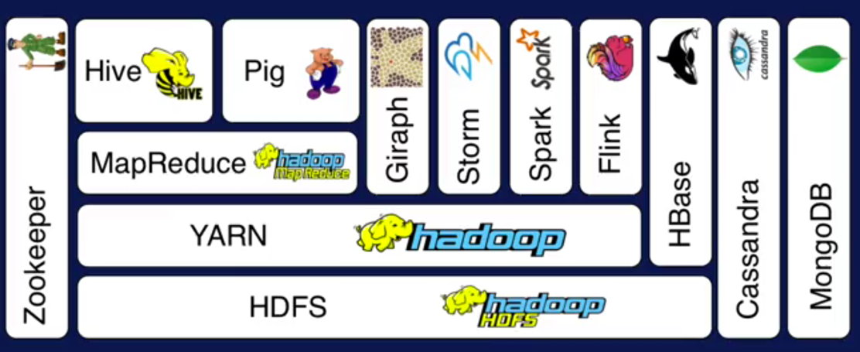
Hadoop Ecosystem
Pig: High-level language for data analysis (Yahoo! Research)
Hive: SQL-like Query language and Metastore (Facebook)
HBase: Table storage for semi-structured data (Modeled on Google’s Bigtable)
Zookeeper: Coordinating distributed applications
Mahout: Machine learning

Slide 78
In-Memory Cluster Computing
Apache Spark

Slide 79
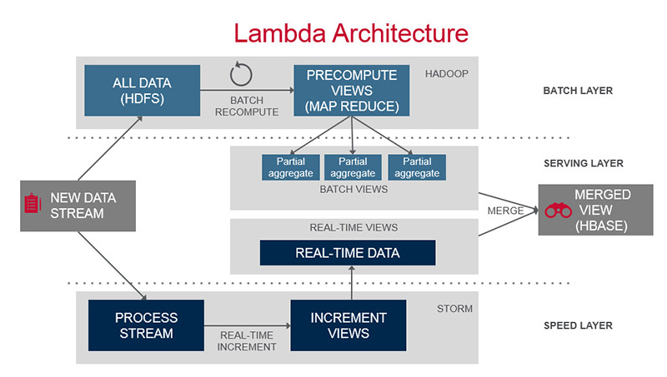
Overview of LAMBDA Architecture
The Lambda Architecture has three major components:
Batch layer provides the following functionality
managing the master dataset, an immutable, append-only set of raw data
pre-computing arbitrary query functions, called batch views.
Serving layer
indexes the batch views so that they
can be queried in ad hoc with low latency.
Speed layer
accommodates all requests that are
subject to low latency requirements.
use fast and incremental algorithms
deals with recent data only.

Slide 81
Apache Spark
Spark is a general-purpose computing framework for iterative tasks
API is provided for Java, Scala and Python
The model is based on MapReduce
enhanced with new operations and an engine that supports execution graphs
Tools include Spark SQL, MLLlib for machine learning, GraphX for graph processing and Spark Streaming
Unifies batch, streaming, interactive computing
Making it easy to build sophisticated applications

Slide 82
Key idea in Spark
Resilient distributed datasets (RDDs)
Immutable collections of objects across a cluster
Built with parallel transformations (map, filter, …)
Automatically rebuilt when failure is detected
Allow persistence to be controlled (in-memory operation)
Transformations on RDDs
Lazy operations to build RDDs from other RDDs
Always creates a new RDD
Actions on RDDs
Count, collect, save

Slide 83
Spark overview

Slide 84
YARN

Slide 85
MESOS Architecture
Apache Mesos is an open source cluster manager that handles workloads in a distributed environment through dynamic resource sharing and isolation.

Slide 86
Task Scheduler
Supports general task graphs
Pipelines functions where possible
Cache-aware data reuse & locality
Partitioning-aware to avoid shuffles
MESOS provides resource
allocation (offer resources to
framework, accept/reject by
framework scheduler)

Slide 87
Implementing Spark Algorithms
Broadcast everything
Master broadcasts data and initial models
At each iteration updated models are broadcast by master (driver program)
Does not scale well due to communication overhead
Data parallel
Worker loads data
Master broadcasts initial models
At each iteration updated models are broadcast by master
Works for large datasets, because data is available to workers
Fully parallel
Workers load data and they instantiate the models
At each iteration, models are shared via join between workers
Much better scalability

Slide 88
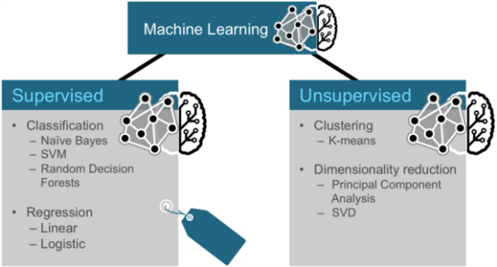
Machine Learning and Spark
Spark RDDs support efficient data sharing
In-memory caching increases performance
Reported to have performance of up to 100 times faster than Hadoop in memory or 10 times faster on disk
High-level programming interface for complex algorithms

Slide 89
MLBase and MLlib
MLBase has been designed for simplifying the development of
machine learning pipelines:
MLlib is a machine learning library
MLI (ML Developer API) is an API for machine learning development that aims to abstract low-level details from the developers
MLOpt is a declarative layer that aims to automate the machine learning pipeline
The idea is that the system searches feature extractors and models best fit for the ML task

Slide 90
Graph-Parallel Systems
Graph-based computation depends only on the neighbors of a
particular vertex
“Think like a Vertex.” – Pregel (SIGMOD 2010)
Systems with specialized APIs to simplify graph processing
Pregel from Google
Push abstraction: Vertex programs interact by sending messages
Receive msgs, process, send msgs
GraphLab
Pull abstraction: Vertex programs access adjacent vertices and edges
Foreach (j in neighbours) calculate pagerank total for j

Slide 91
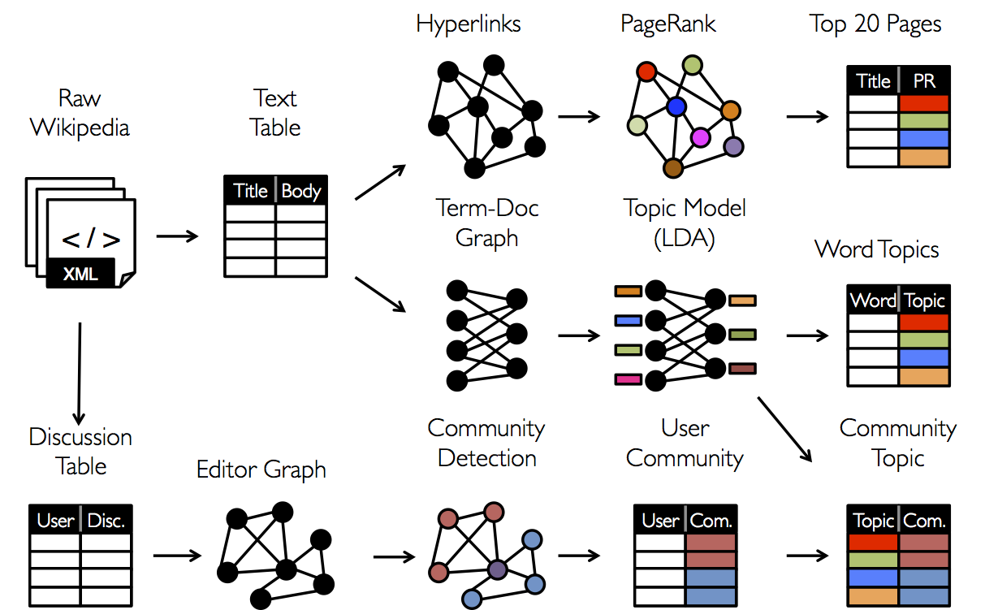
GraphX
Separation of system support for each view (table, graph) involves expensive data movement and duplication
GraphX makes tables and graphs views of the same physical data
The views have
their own optimized
semantics
Table operators
inherited from Spark
Graph operators
form relational algebra

Slide 92
Performance Gains for PageRank Revisited
Spark is reported to be 4x faster than Hadoop
Graphlab is 16x faster than Spark
GraphX is roughly 3x slower than Graphlab
GraphX is reported to compare favourably to Graphlab with
pipelines (raw -> hyperlink -> pagerank -> top 20)
Graph structure can be exploited for significant performance gains

Slide 93
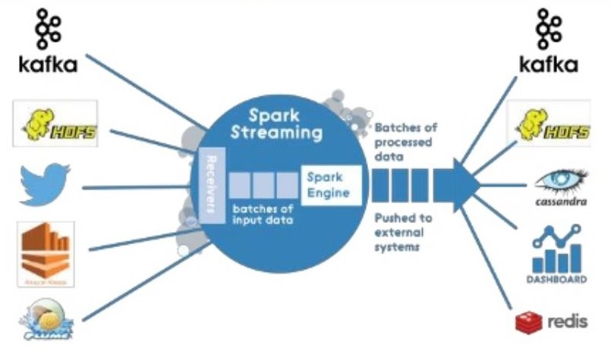
Spark Streaming
Spark extension of accepting and processing of streaming high-throughput live data streams
Data is accepted from various sources
Kafka, Flume, TCP sockets, Twitter, …
Machine learning algorithms and graph processing algorithms can be applied for the streams
Similar systems
Twitter (Storm),
Google (MillWheel),
Yahoo! (S4)

Slide 94
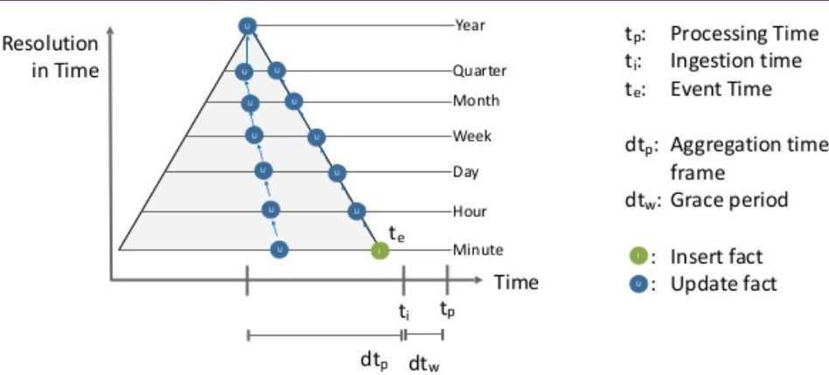
Stream Processing: Discretized
Streaming computation: a series of very small deterministic batch jobs
Live stream is divided into batches of x seconds
Each batch of data is an RDD and RDD operations can be used
Results are also returned in batches
Batch size as low as 0.5 seconds, results in approx. One second latency
Can combine streaming and batch processing
Click stream processing example
Event vs. Processing Time
There’s a difference between even time (te) and processing time (tp)
Events arrive out-of order even during normal operation
Events may arrive arbitrary late
Apply a grace period before processing events
Allow arbitrary update windows of metrics

Slide 95
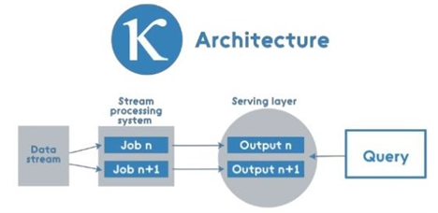
K – Architecture
A distributed data operating system is emerging
Supported by YARN and MESOS
Various data services on top of this (Hadoop and Spark)
Some services are being integrated (for example in Spark) for better coherence and performance
Important points
Data format (row/column, block size)
Network topology and data/code placement
Algorithm structure and coordination
Scheduling and resource management
Big Data Frameworks are evolving
Spark represents unification of streaming, machine learning and graphs
Big Data pipeline management is at an early stage
How to achieve better mapping between cluster resources, scheduling, and pipelines?

Slide 96
Frameworks for real-time data stream analytics
Apache Storm

Slide 97
Apache Storm Architecture
Nimbus:
Distributes codes around cluster
Assigns tasks to machines supervisors
Failure monitoring
Is fail-fast and stateless
Supervisor:
Listens for work assigned to its machine
Starts and stops worker processes
Shuts down worker processes
Topology: process messages forever
A running topology consists of many worker processes spread across many machines (graph of computation)
Zookeper:
Handle cluster coordination
Monitor working node status
helps the Supervisor to interact with the Nimbus
Supervisor
ZooKeeper
Supervisor
Nimbus
ZooKeeper
Supervisor
ZooKeeper
Supervisor
Supervisor
Supervisor

Slide 98
Apache Storm
Simple programming model
Topology - computation graph that run forever
node in a topology contains processing logic
links between nodes indicate how data should be passed around between nodes
Spouts - source of streams
Bolts - consumes input streams
Programming language agnostic
( Clojure, Java, Ruby, Python default )
Fault-tolerant
Horizontally scalable
Ex: 1,000,000 messages per second on a 10 node cluster
Guaranteed message processing
Fast : Uses zeromq message queue
Local Mode : Easy unit testing

Slide 99
Storm Stream and Spouts
Stream
Unbounded sequence of tuples ( storm data model ) • <key, value(s)> pair ex. <“UIUC”, 5>
Spouts
Source of streams : Twitterhose API
Stream of tweets or some crawler
have interfaces that you implement to run application-specific logic

Slide 100
Storm Bolts
Bolts:
Process (one or more) input stream and produce new streams
Functions
Filter, Join, Apply/Transform etc
Parallelize to make it fast! – multiple processes constitute a
bolt

Slide 101
Storm Topology & Grouping
Topology:
Graph of computation – can have cycles
Network of Spouts and Bolts
Spouts and bolts execute as many tasks across the cluster
Grouping
How to send tuples between the components / tasks?
Shuffle Grouping
Distribute streams “randomly” to bolt’s tasks
Fields Grouping
Group a stream by a subset of its fields
All Grouping
All tasks of bolt receive all input tuples useful for joins
Global Grouping
entire stream goes to a single one of the bolt's tasks
Pick task with lowers id

Slide 102
Zookeeper
Open source server for highly reliable distributed coordination.
As a replicated synchronization service with eventual consistency;
Features:
Robust
Persistent data replicated across multiple nodes
Master node for writes
Concurrent reads
Comprises a tree of znodes, - entities roughly representing file system nodes.
Use only for saving small configuration data.

Slide 103
Storm Message Processing
Guranteed Message Processing:
Message is "fully processed" when the tuple tree has been exhausted and every message in the tree has been processed
A tuple is considered failed when its tree of messages fails to be fully processed within a specified timeout.

Slide 104
Fault Tolerance APIS
Emit(tuple, output)
Emits an output tuple, perhaps anchored on an input tuple (first argument)
Ack(tuple)
Acknowledge that you (bolt) finished processing a tuple
Fail(tuple)
Immediately fail the spout tuple at the root of tuple topology I there is an exception from the database, etc.
Must remember to ack/fail each tuple
Each tuple consumes memory. Failure to do so results in memory leaks.

Slide 105
Storm Fault Tolerance
Anchoring
Specify link in the tuple tree.
( anchor an output to one or more input tuples.)
At the time of emitting new tuple
Replay one or more tuples.
“acker” tasks
Track DAG of tuples for every spout
Every tuple ( spout/bolt ) given a random 64 bit id
Every tuple knows the ids of all spout tuples for which it exits.
How?
Every individual tuple must be acked.
If not task will run out of memory!
Filter Bolts ack at the end of execution
Join/Aggregation bolts use multi ack .

Slide 106
Failure Handling
A tuple isn't acked because the task died: Spout tuple ids at the root of the trees for the failed tuple will time out and be replayed.
Acker task dies: All the spout tuples the acker was tracking will time out and be replayed.
Spout task dies: The source that the spout talks to is responsible for replaying the messages.
For example, queues like Kestrel and RabbitMQ will place all pending messages back on the queue when a client disconnects.
Major breakthrough : Tracking algorithm
Storm uses mod hashing to map a spout tuple id to an acker task.
Acker task: Stores a map from a spout tuple id to a pair of values.
Task id that created the spout tuple
Second value is 64bit number : Ack Val
XOR all tuple ids that have been created/acked in the tree.
Tuple tree completed when Ack Val = 0
Configuring Reliability
Config.TOPOLOGY_ACKERS to 0.
you can emit them as unanchored tuples

Slide 107
Failure Scenario
Lets take a scenario:
Count aggregation of your stream
Store running count in database. Increment count after processing tuple.
Failure!
Design:
Tuples are processed as small batches.
Each batch of tuples is given a unique id called the "transaction id" (txid).
If the batch is replayed, it is given the exact same txid.
State updates are ordered among batches.
Example:
Processing txid = 3
Database state
man => [count=3, txid=1]
dog => [count=4, txid=3]
apple => [count=10, txid=2]
If they're the same : SKIP
( Strong Ordering )
If they're different,
you increment the count.
man => [count=5, txid=3]
dog => [count=4, txid=3]
apple => [count=10, txid=2]
["man"]
["man"]
["dog"]

Slide 108
Storm Future Improvements
Lax security policies
Performance and scalability improvements
Presently with just 20 nodes SLAs that require processing more than a million records per second is achieved.
High Availability (HA) Nimbus
Though presently not a single point of failure, it does affect degrade functionality.
Enhanced tooling and language support

Slide 109
Machine Learning for Big Data
The Flink model
Based on http://linc.ucy.ac.cy/file/Talks/talks/DeepAnalysiswithApacheFlink_2nd_cloud_workshop.pdf

Slide 110
Data Processing and Machine learning Methods
Data processing (third trend)
Traditional ETL (extract, transform, load)
Data Stores (HBase, ……..)
Tools for processing of streaming,
multimedia & batch data
Machine Learning (fourth trend)
Classification
Regression
Clustering
Collaborative filtering
Data Processing ETL (extract, transform, load)
Big Datasets
Machine
Learning
Distributed Computing
Working at the Intersection of these four trends is very exciting and challenging and require new ways to store and process Big Data

Slide 111
Apache Flink
Massive parallel data flow engine with unified batch- and stream-processing
Batch and Stream APIs on top of a streaming engine
Performance and ease of use
Exploits in-memory processing and pipelining, language-embedded logical APIs
A runtime that "just works" without tuning
custom memory management inside the JVM
Predictable and dependable execution
Bird’s-eye view of what runs and how, and what failed and why

Slide 112
Flink System Stack
Rich set of operators
Map, Reduce, Join, CoGroup, Union, Iterate, Delta Iterate, Filter, FlatMap, GroupReduce, Project, Aggregate, Distinct, Vertex-Update, Accumulators

Slide 113
Flink K-Means Clustering
Cluster analysis in data mining
Partitions n observations into k clusters
Assign points to cluster with smallest (euclidian) distance
Input:
Set of observations X= {x1, x2, …, xn}
Number of clusters K
Convergence criteria K
Result:
Set of clusters C= {c1, c2, …, ck}
Init:select k data points as cluster centroids C= {c1, c2, …, ck}
Compute:
do
foreach x in X
assagin x to cluster with closest centroid
recompute centroido feach cluster
while ξi s not reached (or fixed number of iterations)
16

Slide 114
K-Means in Flink
// initialize
// points: n observations, centroids: initial k centroids
valcntrds= centroids.iterate(10) { currCntrds=>
valnewCntrds= points
.map(findNearestCntrd).withBroadcastSet(currCntrds, "cntrds")
.map( (c, p) => (c, p, 1L) )
.groupBy(0).reduce( (x, y) =>
(x._1, x._2 +y._2, x._3 +y._3) )
.map( x =>Centroid(x._1, x._2 /x._3) )
newCntrds }
{1, 3, 5, 7}.reduce { (x, y) =>x +y }

Slide 115
Flink machine learning library
valfeatureExtractor=HashingFT()
valfactorizer=ALS()
valpipeline =featureExtractor.chain(factorizer)
valclickstreamDS=
env.readCsvFile[(String, String, Int)](clickStreamData)
valparameters =ParameterMap()
.add(HashingFT.NumFeatures, 1000000)
.add(ALS.Iterations, 10)
.add(ALS.NumFactors, 50)
.add(ALS.Lambda, 1.5)
valfactorization =pipeline.fit(clickstreamDS, parameters)
Currently available algorithms: Classification, Logistic Regression, Clustering, Recommendation (ALS- alering least squares)

Slide 116
Ethical Issues on Big Data
Rules and Regulations, Data Economy, Business Models

Slide 117
Big Data Ethics
“Big Data” Revolution comparable with Industrial Revolution
all kinds of human activities and decisions are beginning to be influenced by big data predictions
dating,
shopping,
medicine,
education,
voting,
law enforcement, terrorism prevention, and cybersecurity
Privacy
Privacy as Information Rules
Shared Private Information Can Remain Confidential
Transparency
Identity

Slide 118
Big Data Ethics Principles
Beneficial
it should deliver value to all concerned parties
Progressive
deliver better and more valuable results
minimize data usage to promote more sustainable and less risky analysis
Sustainable
provide value that is sustainable over a reasonable time frame
Data sustainability
Algorithmic sustainability
Device- and/or manufacturer-based sustainability
Respectful
Fair

Slide 119
Key issues for Etics in Big Data
Privacy
Transparency
Confidentiality
Identity protection

Slide 120
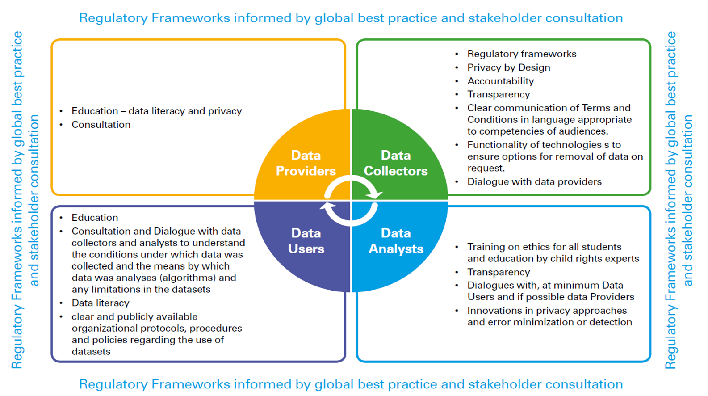

Slide 121
GDPR- General Data Protection Regulation
A piece of legislation passed by the European Union in April of 2016
Purpose was to give consumers better control of their personal data as it’s collected by businesses
It sets limitations on what companies can do with that data and how long they can keep it.
Companies outside of the EU must still comply with the GDPR if they want to do business with customers in the EU
Companies can collect just the minimum amount of data from customers needed to conduct business with the latter.
Furthermore, businesses will be held accountable for the use and storage of that data.
Businesses must designate a Data Protection Officer (DPO) whose function is to oversee details such as GDPR compliance and data security strategy.
If there’s a breach, the DPO must report to affected individuals and the regulators within 72 hours of the incident.
Penalties for non-compliance are tough. A business that violates GDPR laws will pay fines of up to four percent of annual global turnover, or 20 million Euros, whichever is greater.

Slide 122
How GDPR Will Affect Data Collection
GDPR legislation will affect data collection is that it will lead to an increased reliance on real-time analytics
Real-time analytics takes data that has just been collected and puts it to immediate use and analysis.
With collected data getting an immediate turnaround, there is no need for keeping said data around for any great length of time, which is one of the issues that the GDPR seeks to address.
Social media, an avenue that many businesses use for the purpose of building customer loyalty and increasing engagement, will also be affected.
Furthermore, all of that Big Data being collected will have to not only be stored securely but
Will need to be gathered by customers who want to remove it and switch it over to another vendor.
Businesses of all sizes will need to come to terms with the idea that customers will gain greater control over their own personal data.

Slide 123
Case Studies
Trump election
Target pregnancy ad
Brexit campaign
Ted Cruz campaign surge
UK Tory election campaign
Obama campaign
Air France 447 crash
Compas system

Slide 124
Case studies - Trump election
Michal Kosinski in 2008 was accepted by Cambridge University to do his PhD at the Psychometrics Centre
Kosinski joined fellow student David Stillwell about a year after Stillwell had launched a little Facebook application “MyPersonality” app.
enabled users to fill out different psychometric questionnaires, including a handful of psychological questions from the Big Five personality questionnaire
Based on the evaluation, users received a "personality profile"—individual Big Five values—and could opt-in to share their Facebook profile data with the researchers
Kosinski had expected a few dozen college friends to fill in the questionnaire, but before long, hundreds, thousands, then millions of people had revealed their innermost convictions.
Suddenly, the two doctoral candidates owned the largest dataset combining psychometric scores with Facebook profiles ever to be collected

Slide 125
Case studies - Trump election(1)
The approach of Kosinski and his colleagues:
First, they provided test subjects with a questionnaire in the form of an online quiz.
From their responses, the psychologists calculated the personal Big Five values of respondents
openness (how open you are to new experiences?), conscientiousness (how much of a perfectionist are you?), extroversion (how sociable are you?), agreeableness (how considerate and cooperative you are?) and neuroticism (are you easily upset?)
we can make a relatively accurate assessment of the kind of person in front of us. This includes their needs and fears, and how they are likely to behave
Kosinski's team then compared the results with all sorts of other online data from the subjects: what they "liked," shared or posted on Facebook, or what gender, age, place of residence they specified, for example.
Remarkably reliable deductions could be drawn from simple online actions:
men who "liked" the cosmetics brand MAC were slightly more likely to be gay;
one of the best indicators for heterosexuality was "liking" Wu-Tang Clan
Followers of Lady Gaga were most probably extroverts, while those who "liked" philosophy tended to be introverts
While each piece of such information is too weak to produce a reliable prediction, when tens, hundreds, or thousands of individual data points are combined, the resulting predictions become really accurate

Slide 126
Case studies - Trump election(2)
Kosinski and his team tirelessly refined their models.
In 2012, Kosinski proved that on the basis of an average of 68 Facebook "likes" by a user, it was possible to predict their skin color (with 95 percent accuracy), their sexual orientation (88 percent accuracy), and their affiliation to the Democratic or Republican party (85 percent).
But it didn't stop there. Intelligence, religious affiliation, as well as alcohol, cigarette and drug use, could all be determined.
From the data it was even possible to deduce whether someone's parents were divorced.
The strength of their modeling was illustrated by how well it could predict a subject's answers.
Kosinski continued to work on the models incessantly: before long, he was able to evaluate a person better than the average work colleague, merely on the basis of ten Facebook "likes."
Seventy "likes" were enough to outdo what a person's friends knew,
150 what their parents knew, and
300 "likes" what their partner knew.
More "likes" could even surpass what a person thought they knew about themselves. On the day that Kosinski published these findings, he received two phone calls. The threat of a lawsuit and a job offer. Both from Facebook.

Slide 127
Case studies - Trump election (3)
Only weeks later Facebook "likes" became private by default.
Before that, the default setting was that anyone on the internet could see your "likes."
But this was no obstacle to data collectors: while Kosinski always asked for the consent of Facebook users, many apps and online quizzes today require access to private data as a precondition for taking personality tests.
Anybody who wants to evaluate themselves based on their Facebook "likes" can do so on Kosinski's website, and then compare their results to those of a classic Ocean questionnaire, like that of the Cambridge Psychometrics Center.

Slide 128
Case studies - Trump election (4)
But it was not just about "likes" or even Facebook: Kosinski and his team could now ascribe Big Five values based purely on how many profile pictures a person has on Facebook, or how many contacts they have (a good indicator of extraversion).
But we also reveal something about ourselves even when we're not online.
For example, the motion sensor on our phone reveals how quickly we move and how far we travel (this correlates with emotional instability).
Our smartphone, Kosinski concluded, is a vast psychological questionnaire that we are constantly filling out, both consciously and unconsciously.

Slide 129
Vă mulțumim!

